Slide 1
NAME- ANIKET PHAPALE BRANCH- DATA SCIENCE PROJECT NAME- EXCEL CAPSTONE PROJECT ON AVOCADO SALES. (ANALYSIS OF AVOCADO SALES DATASET)

Slide 2
About the project:
The project deals with descriptive analysis of the dataset from Kaggle.com. The project mainly deals with the study of e-commerce sales dataset of a “Avocado”.
The dataset consist of sales transactions recorded during the period of particular dates.dataset include 11 columns an 18250.The columns included sr no,date,average price,total volume,total bags ,small bags,large bags,xlarge bags ,type,year and region.
The study will help startup to compare their current business with the before scenario.this study will also help startup to dive deep and gain insight about their customer base product performance and sales for the past years and the strategize and take decisions accordingly to improve their sales.
Presentation video link: https://drive.google.com/file/d/1_3iqvc4kFOZxW7nk1EhycGg9XA5ojyYv/view?usp=sharing

Slide 3
Problem statements: 1.Find avocado total price by region. 2.Find maximum total bags by region. 3.Find total volume by type. 4.Find total xlarge bags and large bags by type. 5.Find large bags by quarters. 6.Find small bags by years and quarters. 7.Find extra large bags and its total price by type. 8.Find total large bags and its price by years. 9.Find total small bags and its total price by type. 10.Find maximum total bags and minimum volume by year. 11.Make a dashboard for all charts

Slide 4
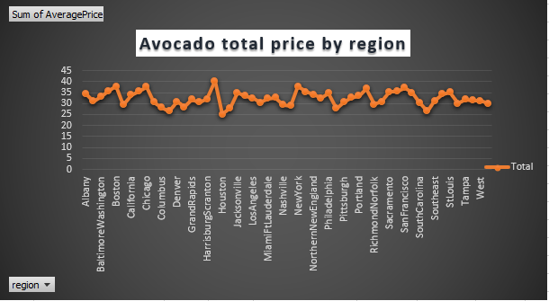
1.Find avocado total price by region.

Slide 5
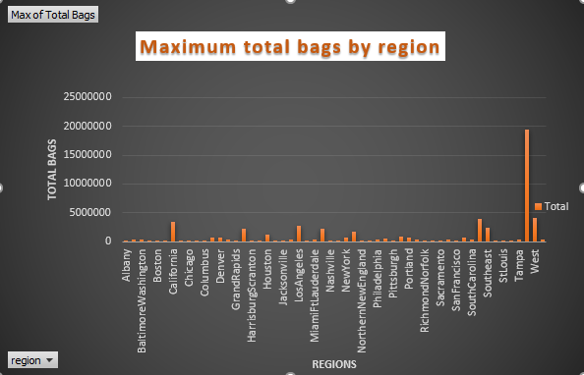
2.Find maximum total bags by region.

Slide 6
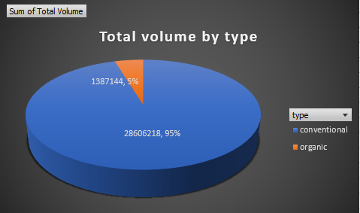
Find total volume by type.

Slide 7
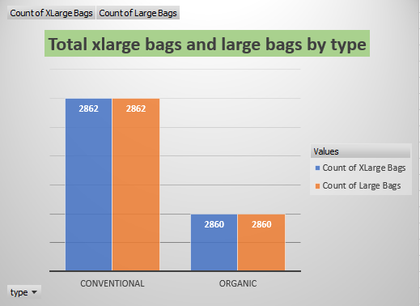
4.Find total xlarge bags and large bags by type.

Slide 8
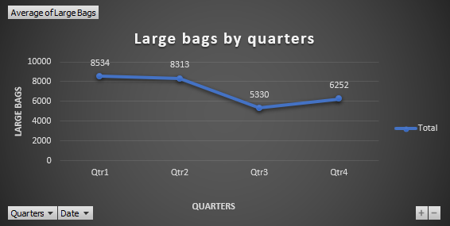
5.Find large bags by quarters

Slide 9
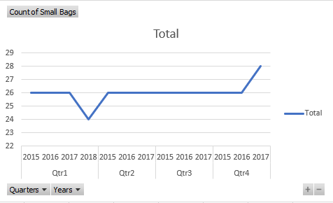
6.Find small bags by years and quarters.

Slide 10
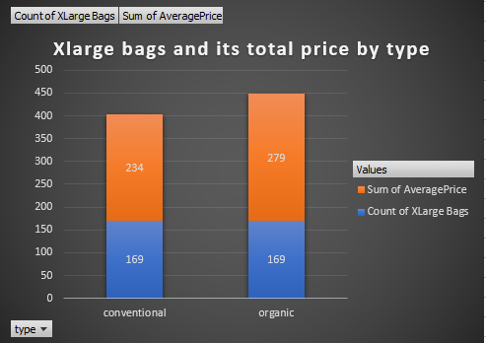
7.Find extra large bags and its total price by type.

Slide 11
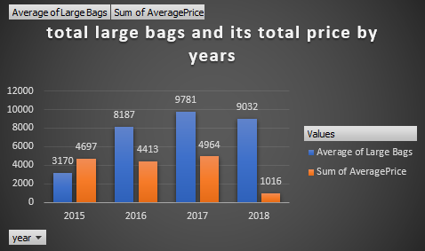
8.Find total large bags and its price by years.

Slide 12
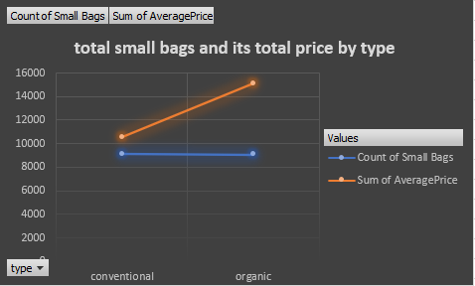
9.Find total small bags and its total price by type

Slide 13
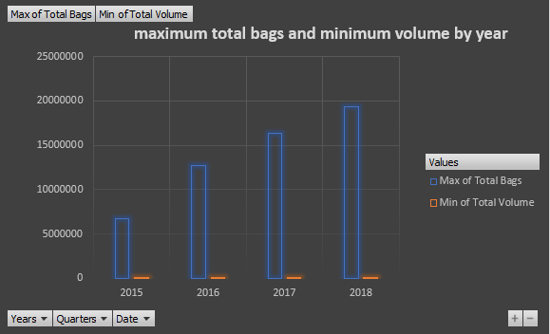
10.Find maximum total bags and minimum volume by year.

Slide 14
Dashboard

Slide 15
THANK YOU…

Slide 16
Presentation video link:
https://drive.google.com/file/d/1_3iqvc4kFOZxW7nk1EhycGg9XA5ojyYv/view?usp=sharing

